Slide 1
Network Theory in Financial Systems
Jasmine Fan and Smita Patankar

Slide 2
References
Eboli, Mario, 2004. Systemic risk in financial networks: a graph theoretic approach. Mimeo Universita di Chieti Pescara
Ahuja, K. R., Magnanti, T. L. and Orlin, J. B. (1993) Network Flows: theory, algorithms and applications, Prentice Hall, New Jersey
Nier, E., Yang, J., Yorulmazer, T. and Alerton, A. (2007) Network
models and Financial stability, forthcoming in the Journal of Economic
Dynamics and Control
Ford, L. R. Jr. and Fulkerson, D. R. (1956) "Maximal flow through a
network," Canadian Journal of Mathematics, vol. 8, pp. 339-404

Slide 3
INTRODUCTION
What is graph theory?
What is network theory?
Applications
Network Theory and Systematic Risk
Coding Example

Slide 4

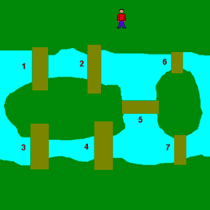
Graph Theory
lBegun in 1735
lBridges of Konigsberg (today’s Kaliningrad):
walk all 7 bridges without crossing a bridge twice
Notes:
The city of Konigsberg (Russia) has seven bridges. A popular pasttime in the city was attempting to find a walk such that you cross each bridge once and only once, without re-tracing steps. Euler proved that is impossible. He was a wet blanket at bridge parties.

Slide 5
Network Theory
Network theory, a part of graph theory, concerns itself with the study of graphs as a representation of either symmetric relations or, more generally, of asymmetric relations between discrete objects.
-Travers and Milgram’ s work on the small world is responsible for the folklore that “everyone is connected by a chain of about “six steps”
Clustering coefficient:
probability that two randomly selected neighbors are connected to each other.
cc1(v) = number of pairs of neighbors actually connected by edges
number of pairs of neighbors
Notes:
modern analysis study statistical properties of networks

Slide 6
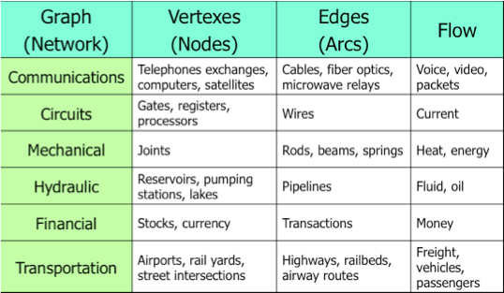
Applications of Network Theory

Slide 7
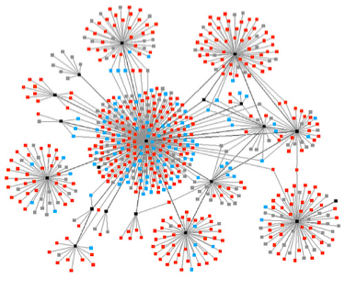
Terminology
Node, edge
Directed path
Directed cycle
Assortative and dissortative

Slide 8
Centrality
A node with much higher degree than most is a “hub.”
“Degree centrality”: simply the node with the most links. Google’s website is currently the highest degree hub online.

Slide 9
Application in Finance
A financial system can be modeled using network theory
Nodes in a network represent all the banks in a financial system and the edges represent links between two banks
The borrowing and lending capital translates to a network inflow or outflow

Slide 10
Systemic Risks in Financial Market
Informational contagion in banking systems
Direct contagion transmitted via links
Common exposure to exogenous drops in the value of assets

Slide 11


Analysis of Propagation
Activation function:
Measures the net worth lost by a node
Insolvency function:
Measures the percentage of the i-th element’s debt that can’t be recovered through liquidation
Feasibility of Propagation====> Minimum Cut-Maximum Flow Theorem
the maximum amount of flow passing from the source to the sink is equal to the minimum capacity that, when removed in a specific way from the network, causes the situation that no flow can pass from the source to the sink.

Slide 12
Acyclic and Cyclic Flow
A cycle flow in a propagation is uniquely defined iff at least one node in the cycle has liabilities towards nodes that do not belong to the cycle.
We will show the proof on board.

Slide 13
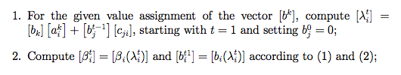
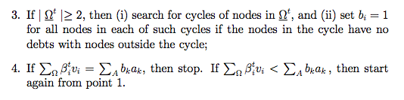
Algorithm for the value of of a propagation
Code: while loop in Matlab, using the previously given functions

Slide 14
How to characterize a network structure
the capitalization of its members
its degree of connectivity
its degree of concentration
the size of the interbank exposures

Slide 15
Future
-understand financial crisis better
-find optimal bank network structure to mitigate risk
-applications in commodity trading, capital exchange among banks

Slide 16
Thank you

